Slide 1
oTree
Philipp Chapkovski
Higher School of Economics
July 28-August 3, 2019

Slide 2
Day 1
oTree admin interface
Studies on mTurk
Creating the first app
oTree project and app structure
Python intro

Slide 3
Day 2
Trust game
Constants
Roles
Page functions (is_displayed, …)
Relational databases
oTree data structure
Tests

Slide 4
Day 3
Public good game
Treatments
Templates
Money
Deployment on Heroku

Slide 5
Day 4
Matching
Dynamic group composition (group_by_arrival_time)
Dynamic fields (min, max, choices)
Matching
Chaining apps

Slide 6
Day 5
Public good game with punishment
Bootstrap
getattr, setattr
mTurk

Slide 7
Exam
30 minutes
Build a simple app based on provided instructions

Slide 8
oTree: alternatives
Lioness http://lioness-lab.org/ - G34, gm15, (Gaechter et al. 'Conducting interactive experiments online' 2018 Experimental Economics)
NodeGame nodegame.org (G8, gm27, 47 Stars, 6 Forks on GitHub)
Gorilla gorilla.sc, proprietary, see paper in PsyArXiv 2018
Sophie https://www.sophielabs.com/ (gm48, Last release 2016)
BreadBoard http://breadboard.yale.edu - Proto stage network project with Christakis (22 Stars, 7 Forks on GitHub)
…
oTree (www.otree.org), (G102, gm890, 219 Stars, 103 Forks on GitHub)

Slide 9
oTree
platform to run interactive online experiments
written on Python
open source
based on Django framework
responsive – can be run in mobile browsers, tablets etc.
Materials and code : | https://chapkovski.github.io/teaching/
My e-mail: | chapkovski@gmail.com
oTree support group: | https://groups.google.com/forum/#!forum/otree
oTree documentation: | http://otree.readthedocs.org/
oTree Hub: | https://www.otreehub.com/

Slide 10
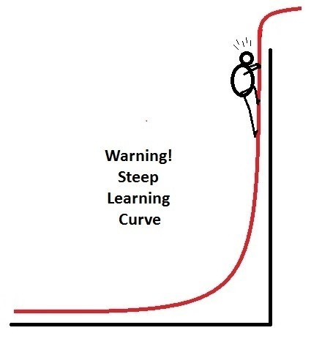
oTree
Languages: Python (backend); HTML, JavaScript, Django template language (frontend)
Backend: Django (M-V-C)
Frontend: Bootstrap
(https://getbootstrap.com)

Slide 11
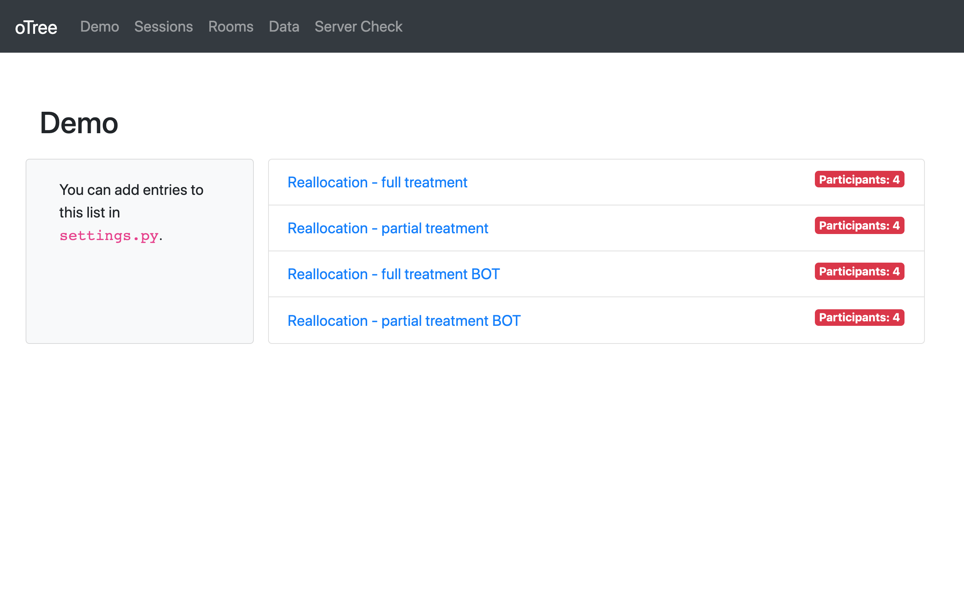
oTree Admin interface

Slide 12
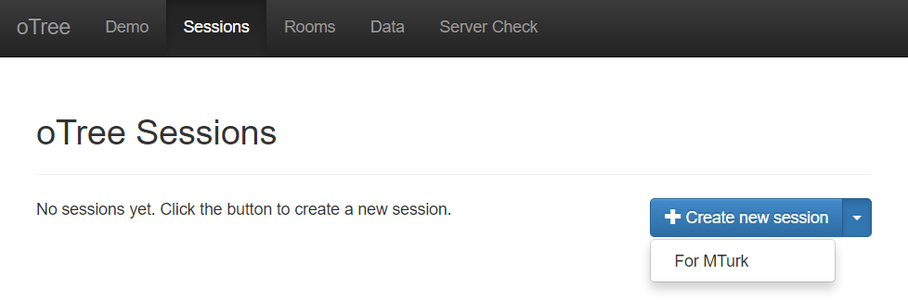
mTurk - BigFive

Slide 13
The first oTree app. Step 1/2
Open the terminal (MacOS), or PowerShell/Command line (Windows)
Check if oTree is installed: otree –version
Create a new project: otree startproject NAMEOFPROJECT
Create a new app:
Change to NAMEOFPROJECT folder: cd NAMEOFPROJECT
Create an app: otree startapp NAMEOFAPP

Slide 14
The first oTree app. Step 2/2
Open NAMEOFPROJECT in PyCharm (or in any other editor of your choice)
register app to settings.py:
SESSION_CONFIGS = [ { 'name': 'my_first_app', 'display_name': "My First App", 'num_demo_participants': 1, 'app_sequence': [' NAMEOFPROJECT '], }, ]
In Terminal: otree devserver
in any browser go to: http://localhost:8000

Slide 15
Three steps to add a new Page
Add Page class definition to pages.py
Add page reference to page_sequence
Create PageName.html in app/templates/app folder

Slide 16


Our main goal:
Show something to the participant.
Get his/her reaction on it

Slide 17
Models
Pages
Templates

Slide 18
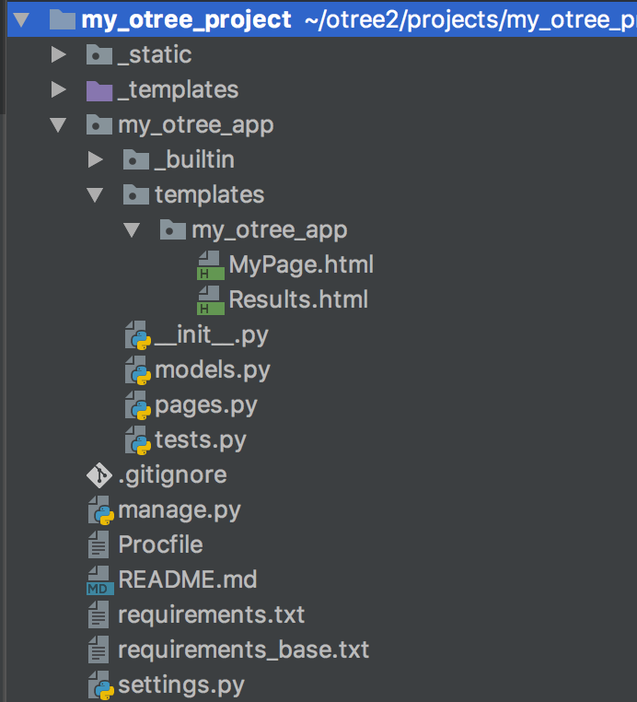

Slide 19
Models are responsible for storing and processing data in the database
Anything that you need to be stored should be defined as a field in models.py file
Models
Pages
Templates

Slide 20
Pages are responsible for retrieving and passing back data from models to templates and vice versa.
If you need to show something to a participant or to get his/her input, you need to state in pages.py
Models
Pages
Templates

Slide 21
Templates are just ordinary html files which get the info from pages and show it to a participant.
As soon as a participant clicks ‘Next’ the data he enters is passed back to pages
Models
Pages
Templates

Slide 22

This is session.
The entire set of all participants in your lab
or online

Slide 23
This is participant.
The entire set of all participants in your lab
or online

Slide 24
Subsession
is a set of all players in one round

Slide 25
Player is an element of
subsession

Slide 26
One participant
contains the info
about all players
who he/she
‘owns’

Slide 27
The group
is a set of players
in one particular
subsession

Slide 28
One session can contain several apps

Slide 29
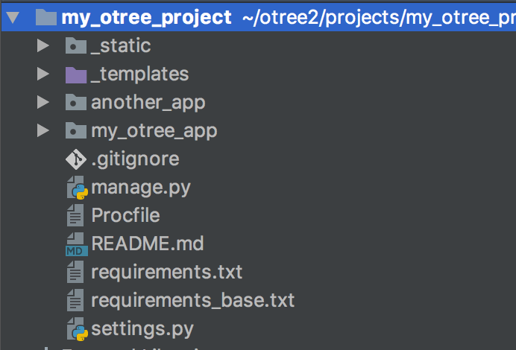
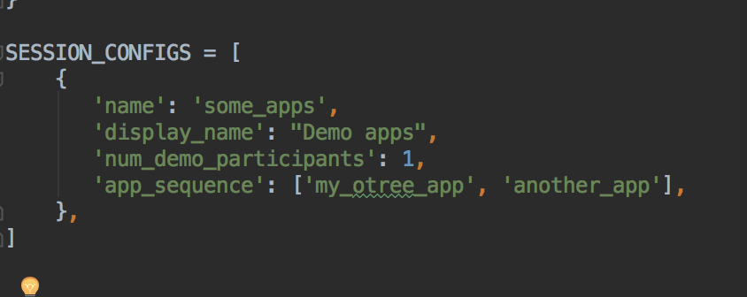
One session can contain several apps
in settings.py:

Slide 30

Very brief introduction

Slide 31
Structure of oTree app
Pages
Page classes
page_sequence
Models
Constants
Player, Group, Subsession
App definition in settings.py
Displaying logic
Data processing

Slide 32
models.py
Constants: fixed set of global parameters, remaining the same for the entire app
Subsession model: data that can change from session to session and from round to round, for the entire set of participants in the specific session
Group model: data that remains the same for the group of players in the specific round (example: total contribution in PGG, Sender's decision in DG/TG)
Player model: data for individual decision makers

Slide 33
models.py
class Constants(BaseConstants): # Base constants of oTree name_in_url = 'myotreeapp' players_per_group = 2 num_rounds = 1 # Any custom parameters: endowment = 100 class Subsession(BaseSubsession): treatment = models.StringField(initial='baseline') class Group(BaseGroup): total_investment = models.IntegerField(initial=100) class Player(BasePlayer): contribution = models.IntegerField(initial=10)

Slide 34
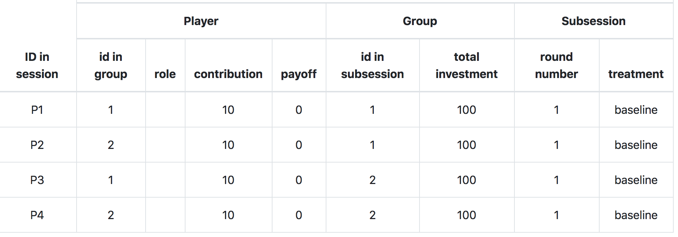
models.py

Slide 35
creating_session method
Subsession model has a special method creating_session
The code there will be executed just before the session starts.
It will be executed as many times as many rounds the game has.
It is used for randomizing initial values and assign treatments
Subsession model also has two other methods:
get_players()
get_groups()

Slide 36
creating_session method
The following code will randomize total investment per group and contribution per individual player:
import random class Subsession(BaseSubsession): def creating_session(self): for g in self.get_groups(): g.total_investment = random.randint(0, 100) for p in self.get_players(): p.contribution = random.randint(0, 10)

Slide 37
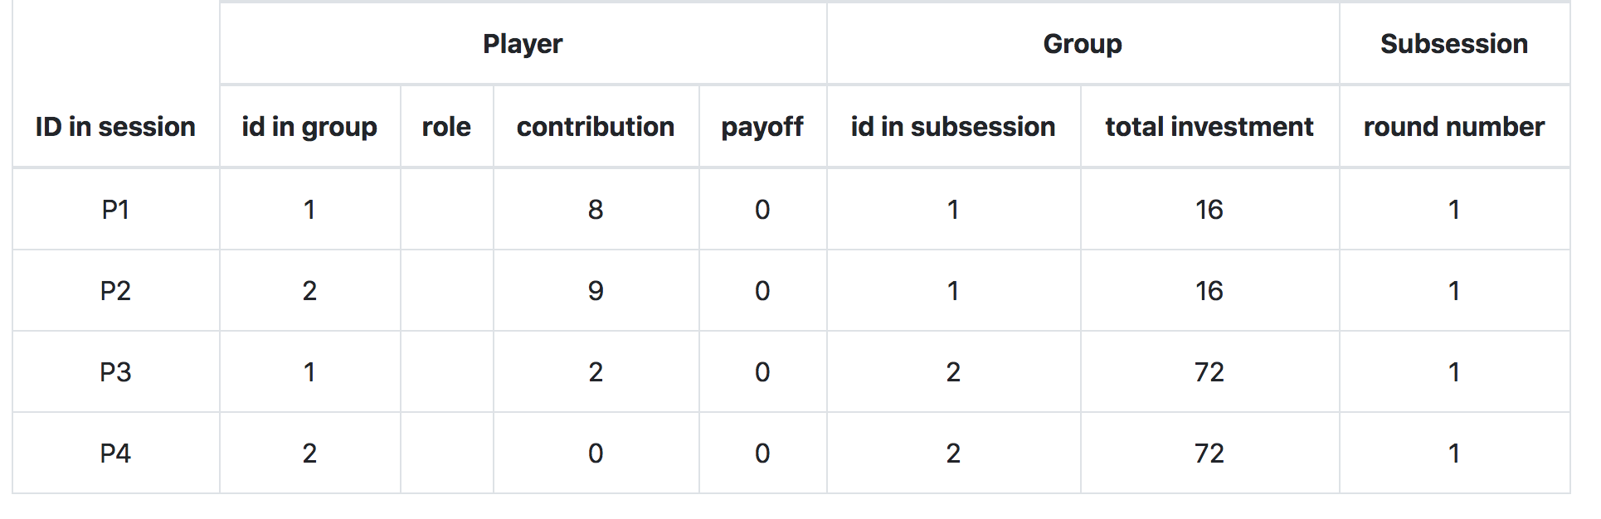
creating_session method
The following code will randomize total investment per group and contribution per individual player:
Result:

Slide 38
player model
built-in attributes:
id_in_group
id_in_subsession
payoff
round_number
DB referrals: participant, group, subsession, session
built-in methods:
get_others_in_group()
get_others_in_subsession()
in_round, in_previous_rounds, in_all_rounds

Slide 39
group model
built-in attributes:
id_in_subsession
round_number
DB referrals: subsession, session
built-in methods:
get_players()
set_players()
get_player_by_id(ID)
get_player_by_role(ROLE)

Slide 40
Anatomy of an oTree Page
Page creation:
class definition
template
When/if/for whom it is shown:
position in page_sequence
is_displayed method
What is shown:
vars_for_template method
What to do next:
before_next_page method

Slide 41
Anatomy of an oTree Page
class MyPage(Page):
form_model = 'player'
form_fields = ['my_field']
page_sequence = [MyPage]

Slide 42
Field form(s) on a template
{% fieldform player.my_field label= ‘Enter something’ %}
OR:
{% for field in form %}
{% formfield field %}
{% endfor %}
OR:
{% formfields %}
OR:
{{ form }}

Slide 43
Methods of an oTree Page
BEFORE page is shown:
is_displayed (should return True if page is to be shown)
vars_for_template (should return variables in a form of dictionary)
AFTER page is shown:
before_next_page

Slide 44
Dynamic set of forms
in Page class:
class MyPage(Page):
def get_form_fields(self):
if self.player.treatment == 'A':
return ['a', 'b']
else:
return ['c', 'd']

Slide 45
Dynamic min/max
you have a field donation; different endowments
in Page class:
class MyPage(Page):
def donation_max(self):
return self.player.endowment

Slide 46
Templates: using variables
In a template you can access variables defined in vars_for_template of the specific page:
{{ var }}
You can also use lists and dictionaries
You can also access any variable in Constants, Player, Group…
{{ player.payoff }}
{{ participant.payoff }}

